Slide 1
CMSC204
Kartchner
V(StateGraph) = {Oregon, Alaska, Texas, Hawaii, Vermont, NewYork, California}
E(StateGraph) = {(Alaska, Oregon), (Hawaii, Alaska), (Hawaii, Texas), (Texas, Hawaii), (Hawaii, California), (Hawaii, New York), (Texas, Vermont), (Vermont, California), (Vermont, Alaska)}
Alaska
1. Draw the StateGraph
Oregon
Vermont
Hawaii
New York
California
Texas
No.
Yes.
Texas

Slide 2
a. Show the adjacency matrix that would describe the edges in the graph. Store the vertices in alphabetical order
States
Alaska
California
Hawaii
New York
Oregon
Texas
Vermont
 |  |  |  | T
T | T |  | T |  | T
 |  | T |  |  |  | T
T | T
3. b. Show the adjacency lists
that would describe the edges in the graph
Alaska
California
Hawaii
New York
Oregon
Texas
Vermont
Oregon
Alaska, California, New York, Texas
Hawaii, Vermont
Alaska, California

Slide 3
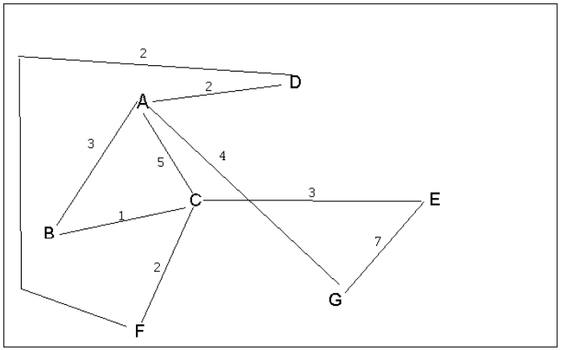
4 a. Which of the following lists the graph nodes in depth first order beginning with E?
A) E, G, F, C, D, B, A
B) G, A, E, C, B, F, D
C) E, G, A, D, F, C, B
D) E, C, F, B, A, D, G
4 b. Which of the following lists the graph nodes in breadth first order beginning at F?
A) F, C, D, A, B, E, G
B) F, D, C, A, B, C, G
C) F, C, D, B, G, A, E
D) a, b, and c are all breadth first traversals

Slide 4
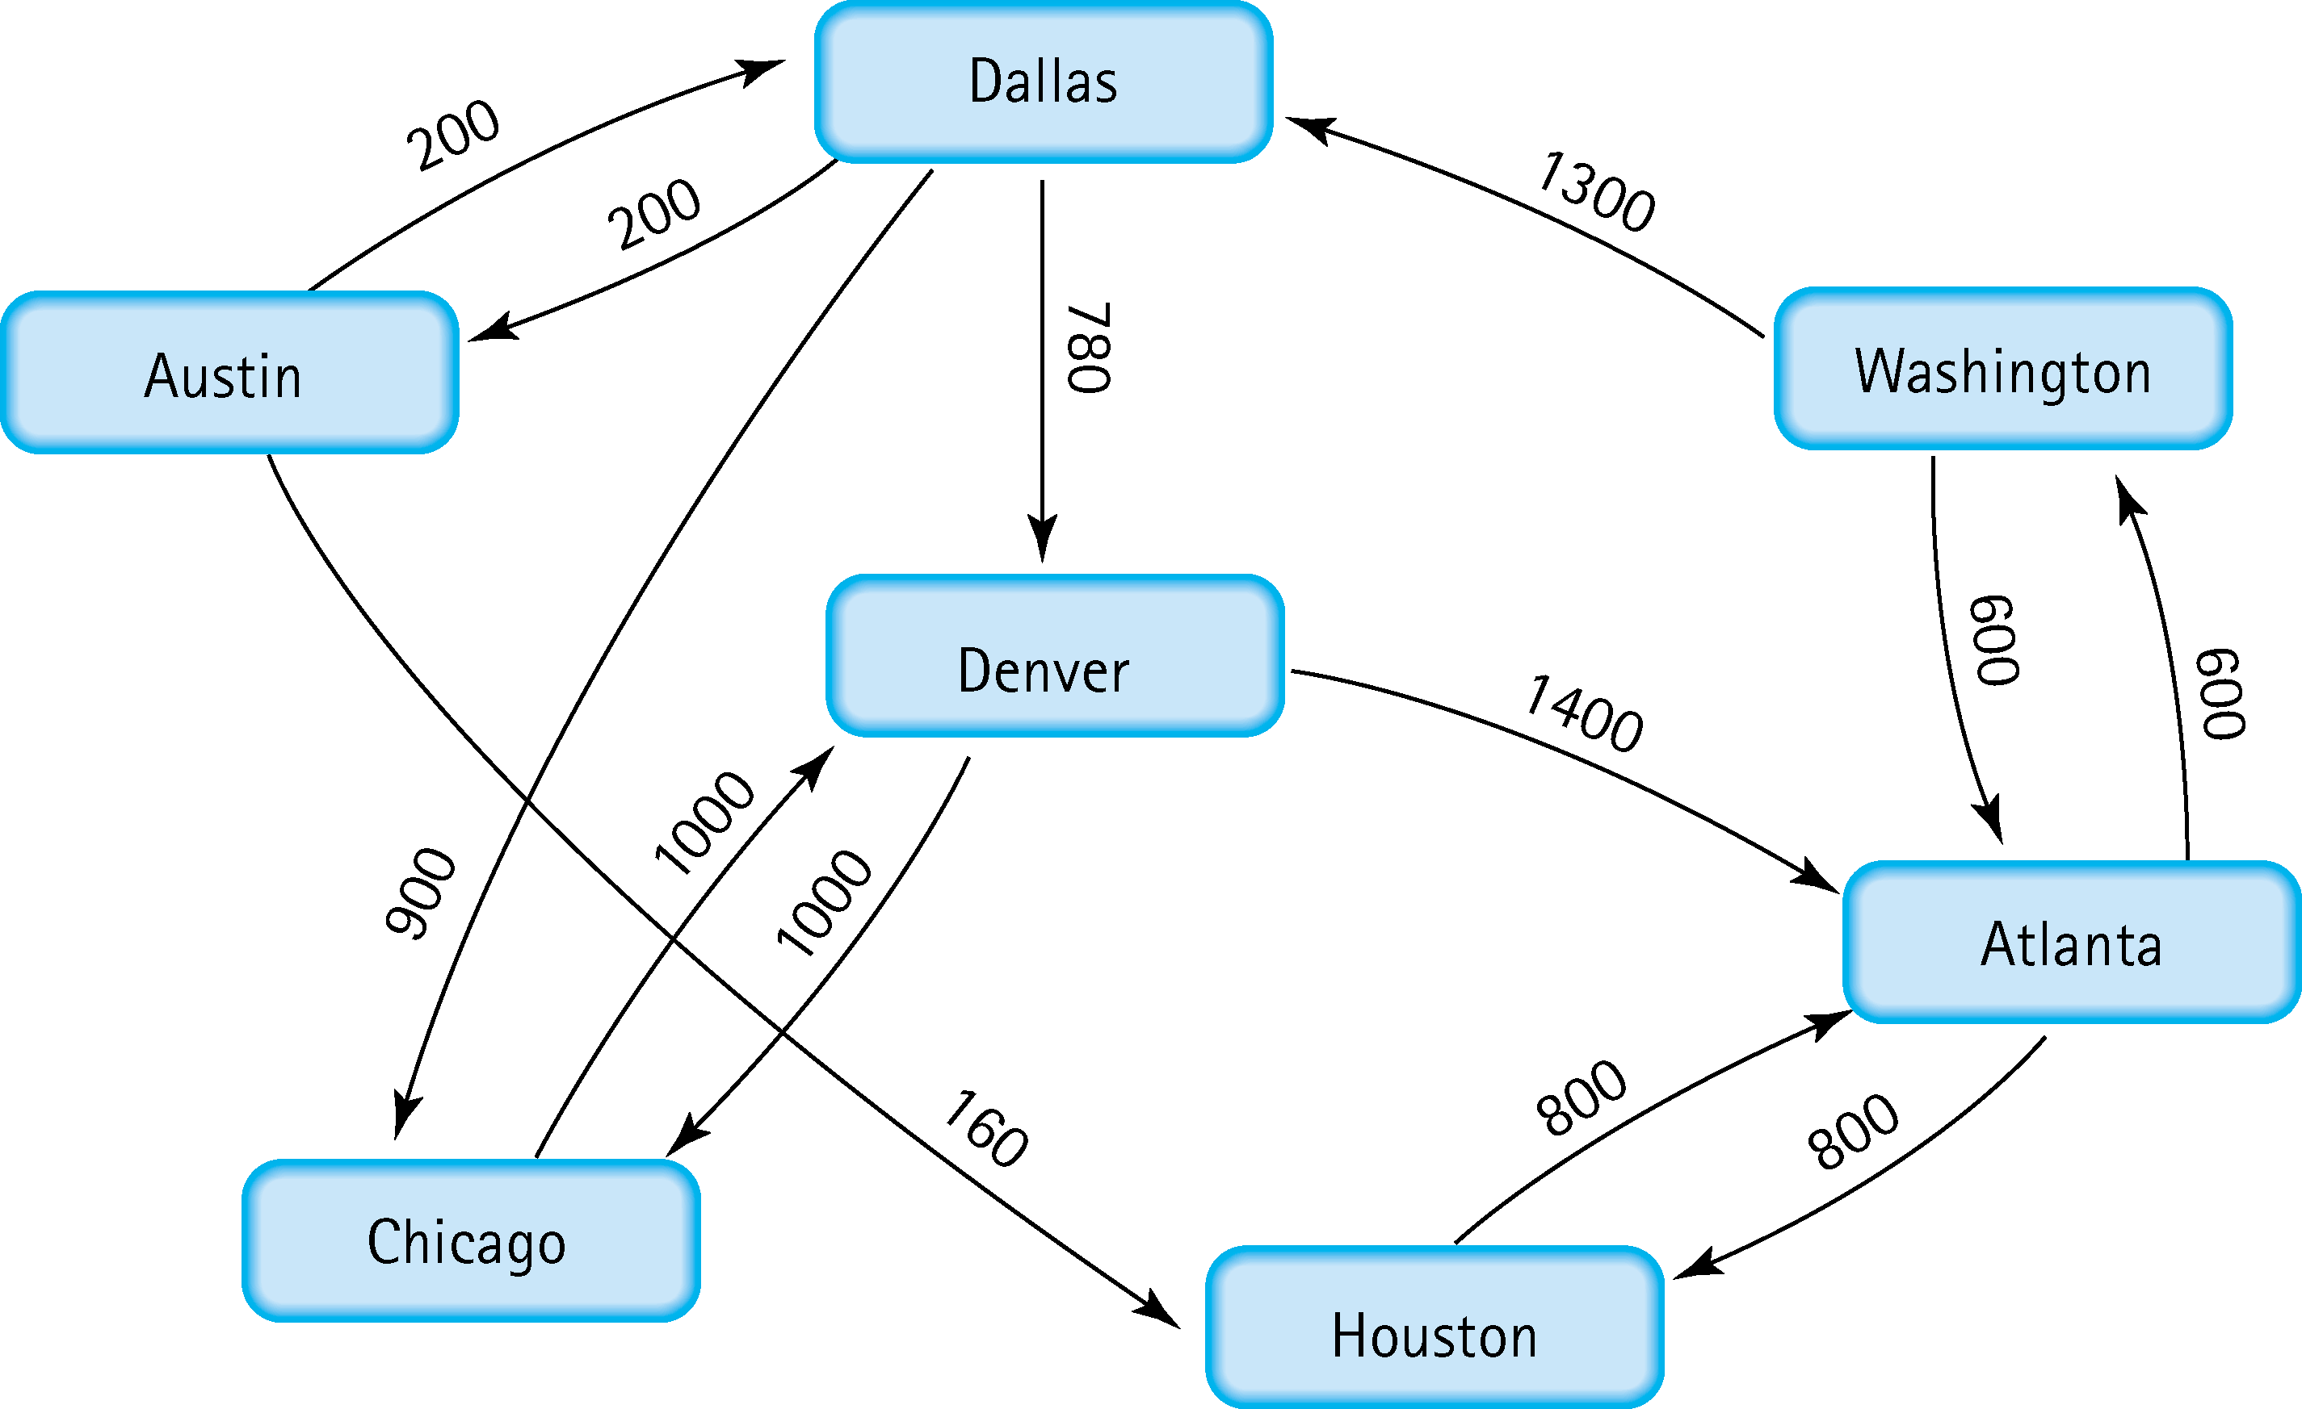
5. Find the shortest distance from Atlanta to every other city
Atlanta to Washington: 600
Atlanta to Houston: 800
Atlanta to Dallas: 1900
Atlanta to Denver: 2680
Atlanta to Austin: 2100
Atlanta to Chicago: 2800

Slide 5
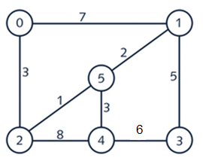
6. Find the minimal spanning tree using Prim’s algorithm. Use
0 as the source vertex . Show the steps.
0
1
2
3
5
5
1
3
2
4
3
Iteration # | Vertex Added | Edge Added | Weight
0 | 0
1 | 2 | 0-2 | 3
2 | 5 | 2-5 | 1
3 | 1 | 5-1 | 2
4 | 4 | 5-4 | 3
5 | 3 | 1-3 | 5
6
7

Slide 6
7. Find the minimal spanning tree using Kruskal’s algorithm.
Show the weights in order and the steps.
0
1
2
3
5
5
1
3
2
4
3
Iteration # | Edge | Weight | Action
1 | 2-5 | 1 | Added
2 | 5-1 | 2 | Added
3 | 5-4 | 3 | Added
4 | 2-0 | 3 | Added
5 | 1-3 | 5 | Added
6 | 3-4 | 6 | Not Added
7 | 0-1 | 7 | Not Added
8 | 2-4 | 8 | Not Added

Slide 7
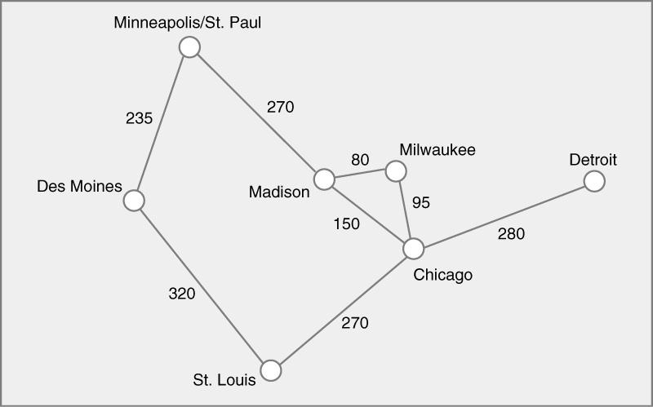
8. Find the minimal spanning tree using the algorithm you prefer. Use
Minneapolis/St. Paul as the source vertex
St. Paul
Detroit
270
Milwaukee
235
80
95
Madison
280
Des Moines
Chicago
270
St. Louis

Slide 8
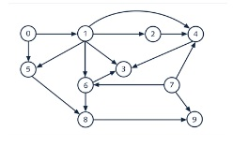
9. List the nodes of the graph in a breadth first topological ordering. Show the
steps using arrays predCount, topologicalOrder and a queue
Step 0
Step 1
Step 2
Vertices
0 | 1 | 2 | 3 | 4 | 5 | 6 | 7 | 8 | 9
1 | 2 | 3 | 4 | 5 | 6 | 8 | 9
2 | 3 | 4 | 5 | 6 | 8 | 9
Pred
Count
0 | 1 | 1 | 3 | 3 | 2 | 2 | 0 | 2 | 2
0 | 1 | 3 | 3 | 1 | 2 | 2 | 2
1 | 3 | 2 | 1 | 1 | 2 | 1
Queue
0 | 7
7 | 1
1
topOrder
0
0 | 7
Step 3
Step 4
Step 5
Vertices
2 | 3 | 4 | 5 | 6 | 8 | 9
3 | 4 | 8 | 9
3 | 8 | 9
Pred
Count
0 | 2 | 1 | 0 | 0 | 2 | 1
2 | 0 | 2 | 1
2 | 1 | 1
Queue
2 | 5 | 6
5 | 6 | 4
6 | 4
0 | 7 | 1
0 | 7 | 1 | 2
0 | 7 | 1 | 2 | 5
topOrder

Slide 9
Step 6
Step 7
Step 8
Vertices
3 | 8 | 9
3 | 9
9
Pred
Count
1 | 0 | 1
0 | 1
0
Queue
4 | 8
8 | 3
3 | 9
0 | 7 | 1 | 2 | 5 | 6
0 | 7 | 1 | 2 | 5 | 6 | 4
0 | 7 | 1 | 2 | 5 | 6 | 4 | 8
topOrder
Step 9
Step 10
Vertices
Pred
Count
Queue
9
0 | 7 | 1 | 2 | 5 | 6 | 4 | 8 | 3
0 | 7 | 1 | 2 | 5 | 6 | 4 | 8 | 3 | 9
topOrder
0 | 7 | 1 | 2 | 5 | 6 | 4 | 8 | 3 | 9

Slide 10
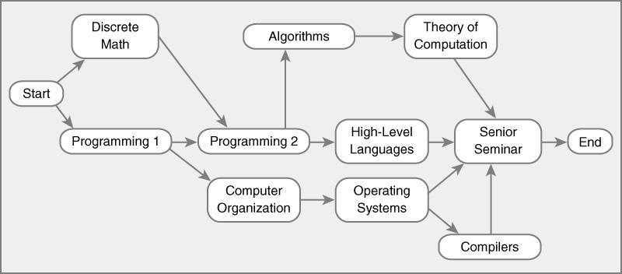
10. List the nodes of the graph in a breadth first topological ordering.
Start, Discrete Math, Programming 1, Programming 2, Computer Organization,
Algorithms, High-Level Languages, Operating Systems, Theory of Computation, Compilers, Senior Seminar, End

